Slide 1
Crypto Data Hourly Price
Group Project for Big Data Management and Governance - A.A. 2023-2024
Paolo Attardi, Martina Fontanesi, Filippo Pattini

Slide 2
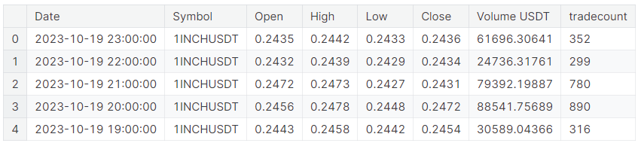
Crypto Market - Dataset Description
This dataset provides a comprehensive collection of hourly price data for 34 major cryptocurrencies, covering a time span from January 2017 to the present day. The dataset includes Open, High, Low, Close, Volume (OHLCV), and the number of trades for each cryptocurrency for each hour (row), making it a valuable resource for cryptocurrency market analysis, research, and trading strategies. Whether you are interested in historical trends or real-time market dynamics, this dataset offers insights into the price movements of a diverse range of cryptocurrencies.
Size (GB) | 0.084
Num. Columns | 8
Num. Rows (x10^6) | 1,16
String Columns | 1
Numeric Columns | 6
Bool Columns | 0
Date Columns | 1
Percentage of Nulls | 0%

Slide 3
Size Breakdown - How the libraries scale?
Pandas, Datatable, Vaex | Optimized to work on big dataset
Polars | Works good in step mode (probably for Lazy Evaluation)
PySpark Pandas | Problem with the size of the dataset (Connection Refused) since it was build to work with distributed systems
Spark, Modin_dask, Modin_ray | Run but with worse performance

Slide 4
Pipeline Preparators
EDA
Sort
Locate_null_values
Is_unique
Data Transformation
Split
Groupby
Data Cleaning
Cast_column_Types
Round
Change_Date_format
Replace

Slide 5
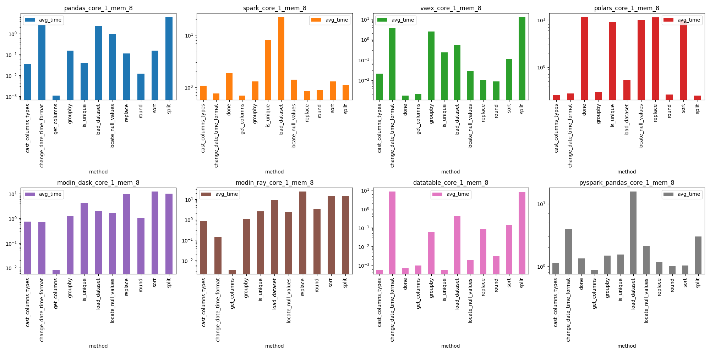
Description of results on Core Preparators

Slide 6
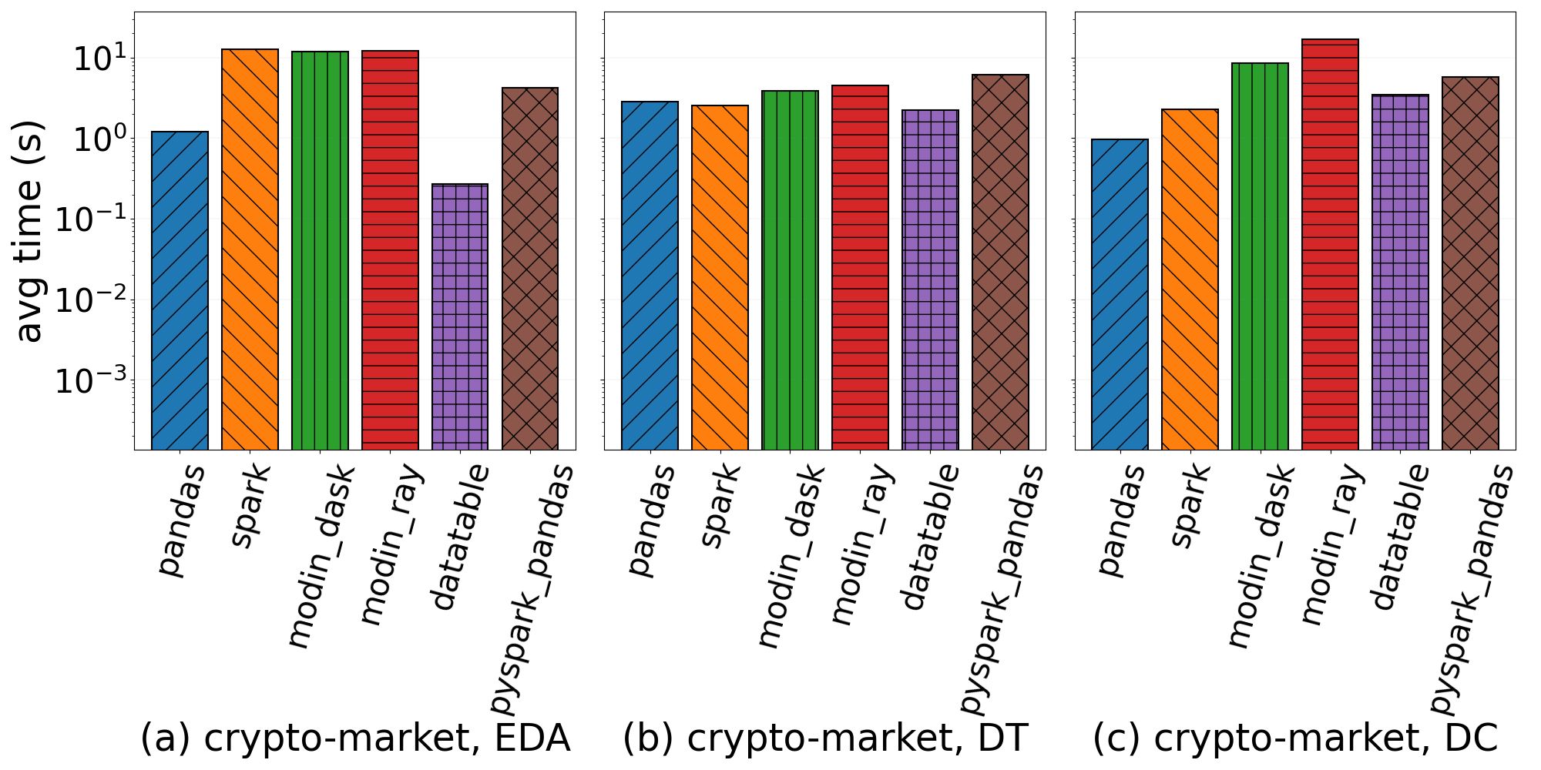
Description of results on Pipeline-Step

Slide 7
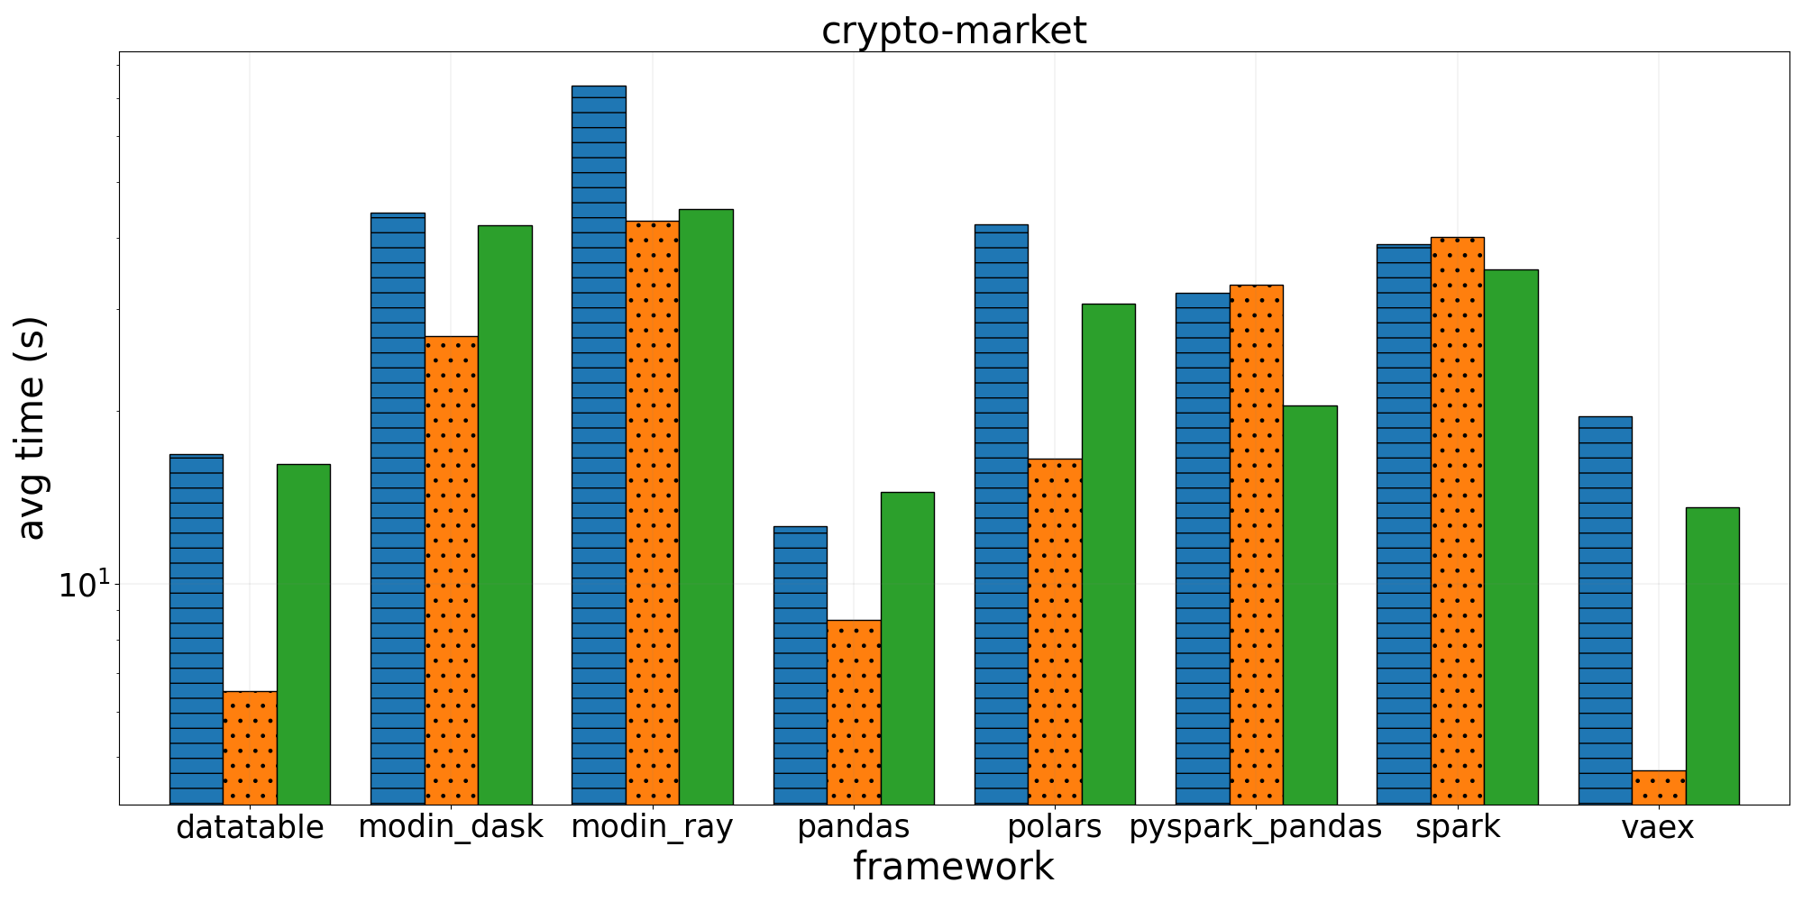
Description of results comparison between Core/Step/Pipe

Slide 8
Conclusion
Problems encountered on the project (if any)
The main problem faced was the execution of pySpark pandas since it was giving us the same problem on different steps (‘connection refused’). The more we developed the pipeline the worst the problem got, to solve it we loaded only a small part of the dataset
Which libraries is the best? Why not other?
The best working libraries are pandas, datatable and vaex given that they are built to work on large datasets. Between our implementations, pandas was the easiest one. The other libraries perform worse as they focus on parallelizing operations rather than managing large datasets.

